Slide 1
CCTV VIDEO OPTIMIZATION
GROUP – 7
ARIVANANDAM-CB.SC.I5DAS21114
KARTHIK S -CB.SC.I5DAS21133
THARUN M S S-CB.SC.I5DAS21163
VISHAL M-CB.SC.I5DAS21172

Slide 2
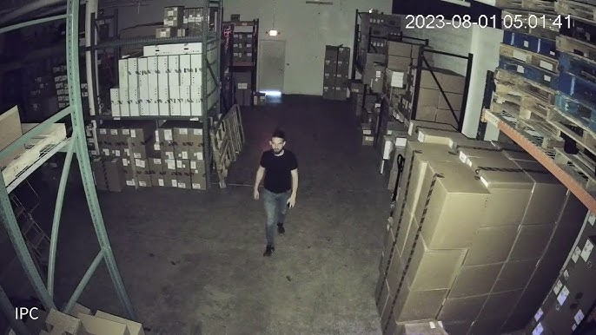
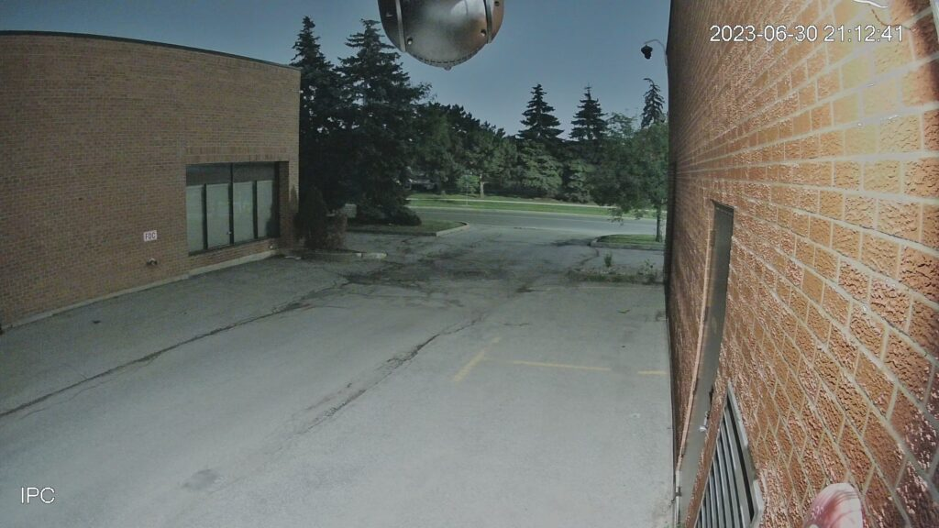
OBJECTIVE :
In growing surveillance technology the optimisation of video is highly required where we are able to optimise cctv footages without leaving out valuable information that is needed. Thus by deploying a deep learning-based solution that optimizes CCTV video storage by detecting human presence and preserving only frames with humans, effectively reducing storage space while ensuring relevant footage is retained.

Slide 3
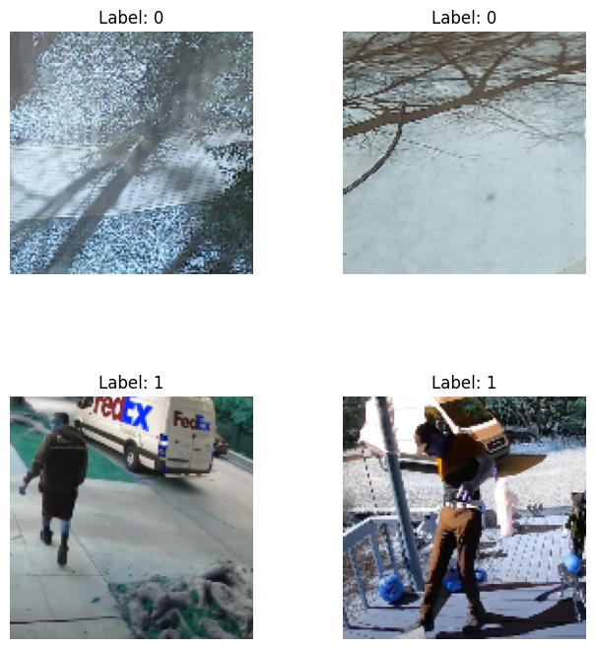
About the data:
https://www.kaggle.com/datasets/constantinwerner/human-detection-dataset/data
Labelled folders as 0 and 1.
0 – no human
1 – human detected

Slide 4
Preprocessing:
Data labelling: Gathered images from a human detection dataset, organized into categories: "No Humans" (0) and "Humans" (1).
Image Resizing: Each image was resized to a standard dimension of 128x128 pixels for uniform input into the model.
Normalization: Pixel values were scaled to a range between 0 and 1 to improve model convergence during training.
Data Augmentation: Techniques like rotation, shifting, zooming, shearing, and flipping were applied to expand the training set and improve model generalization.
Train-Test Split: The dataset was split into training (80%) and testing (20%) sets to evaluate the model’s performance.

Slide 5
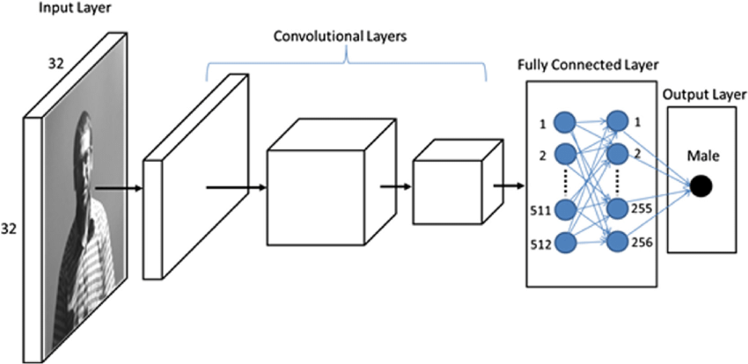
CNN Model creation:
Layers:
Conv2D + BatchNormalization + MaxPooling + Dropout
32 filters, 3x3 kernel, ReLU activation
MaxPooling with 2x2
Dropout at 30% for regularization
Conv2D + BatchNormalization + MaxPooling + Dropout
64 filters, 3x3 kernel, ReLU activation
MaxPooling with 2x2
Dropout at 30% for regularization
Conv2D + BatchNormalization + MaxPooling + Dropout
128 filters, 3x3 kernel, ReLU activation
MaxPooling with 2x2
Dropout at 30%
Conv2D + BatchNormalization + MaxPooling + Dropout
256 filters, 3x3 kernel, ReLU activation
MaxPooling with 2x2
Dropout at 30%
Fully Connected Layer (Dense)
128 neurons, ReLU activation, Dropout 50% for regularization
Output Layer
1 neuron, Sigmoid activation (binary output for human/no human)

Slide 6
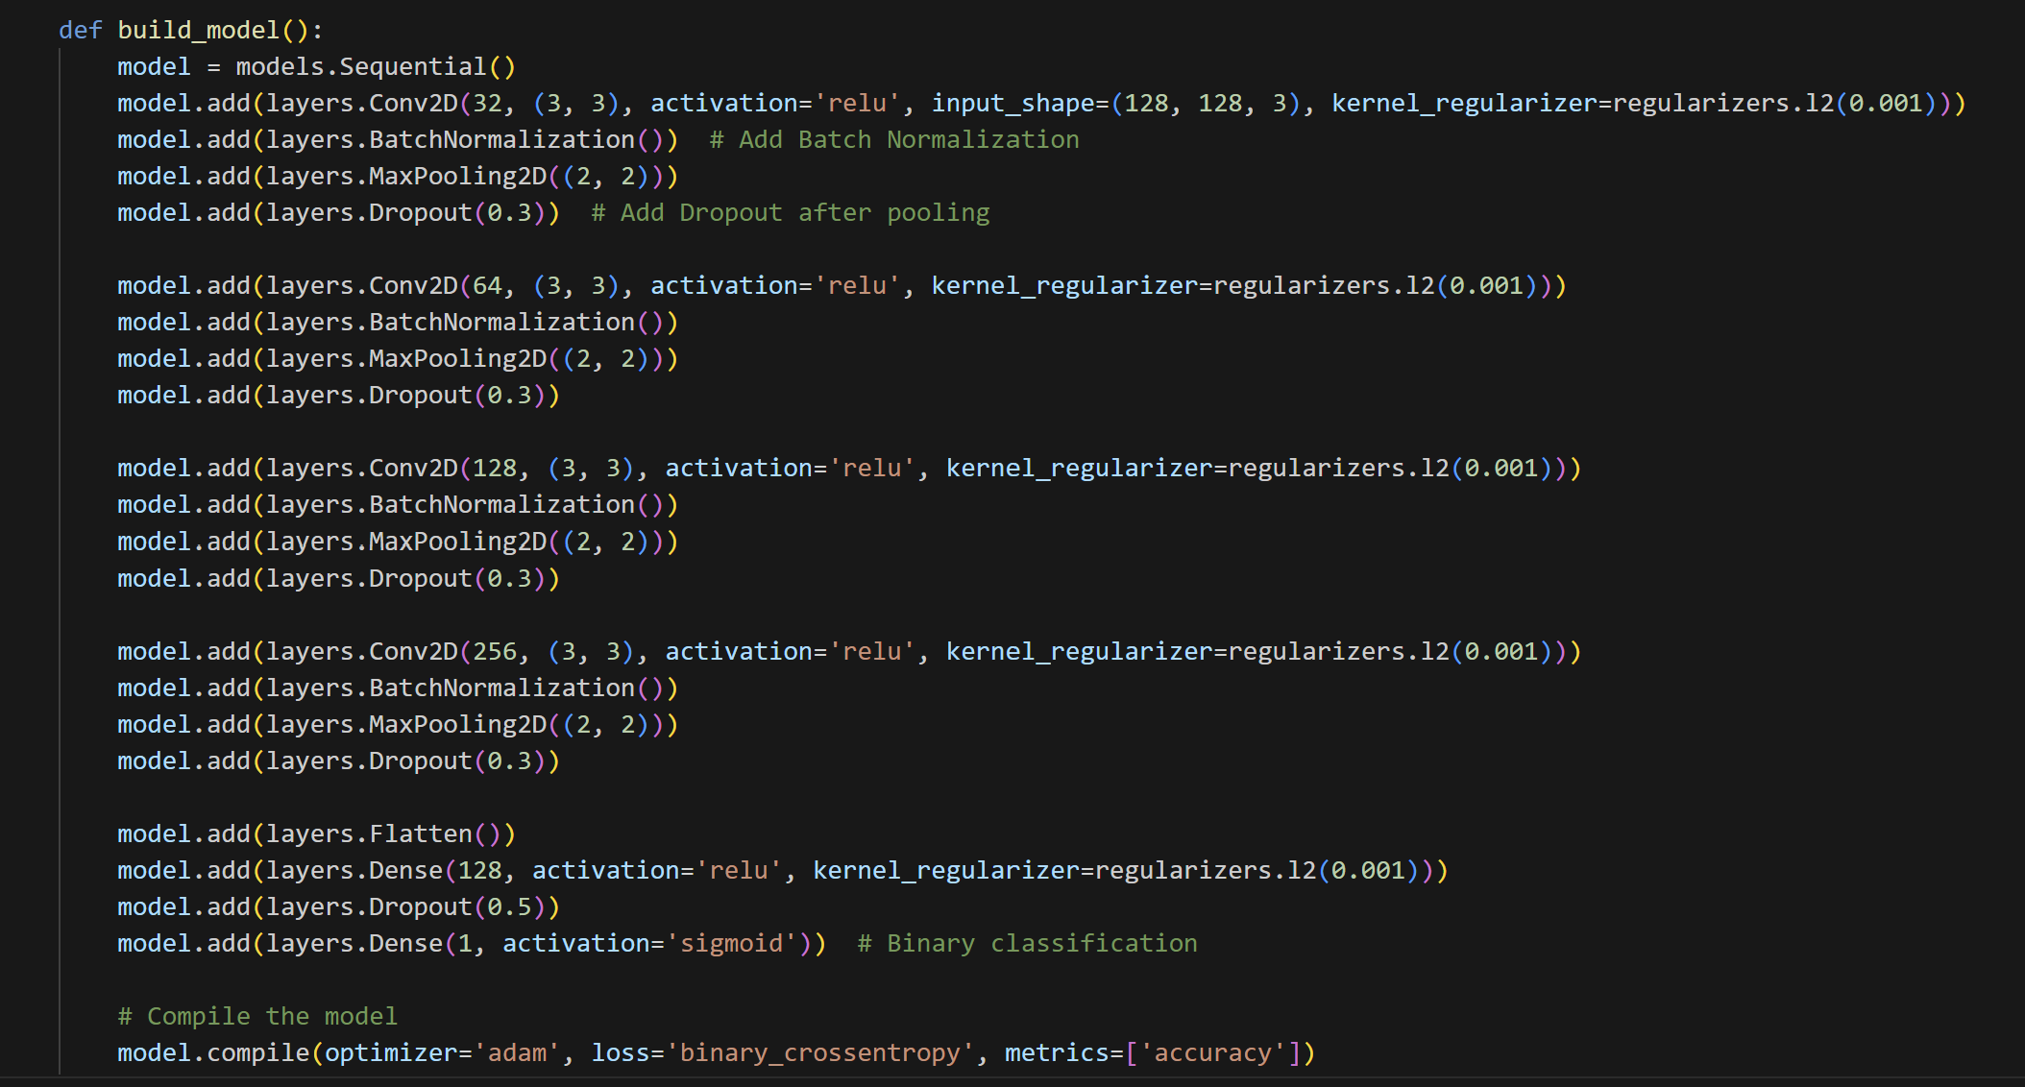

Slide 7
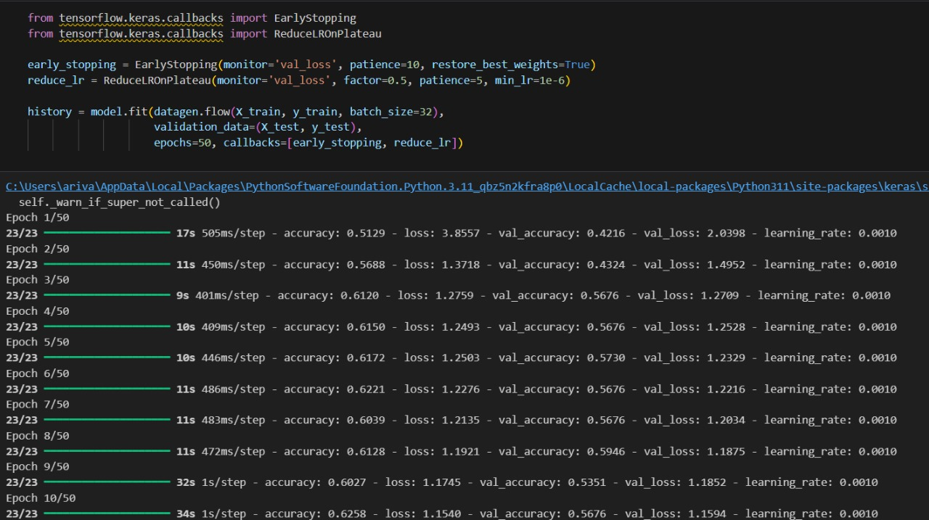

Slide 8
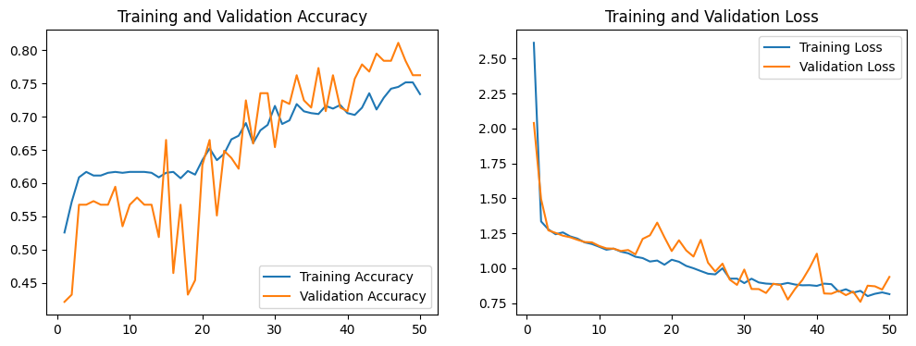
ACCURACY AND LOSS

Slide 9
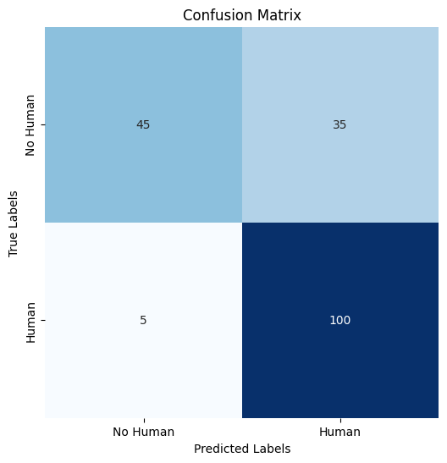
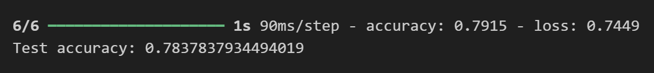
TESTING ACCURACY:
True Negatives (TN): 45 (Top-left)
The model correctly predicted "No Human" when there was no human in the image.
False Positives (FP): 35 (Top-right)
The model incorrectly predicted "Human" when there was actually no human present. This is an error where the model "sees" a human where there isn't one.
False Negatives (FN): 5 (Bottom-left)
The model incorrectly predicted "No Human" when there was actually a human. This error is critical because the model missed detecting a human presence.
True Positives (TP): 100 (Bottom-right)
The model correctly predicted "Human" when there was a human in the image.

Slide 10
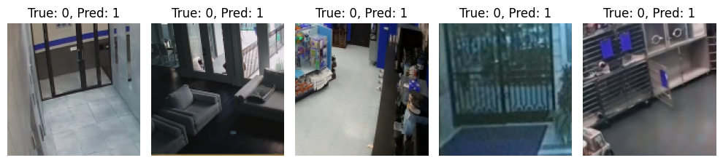
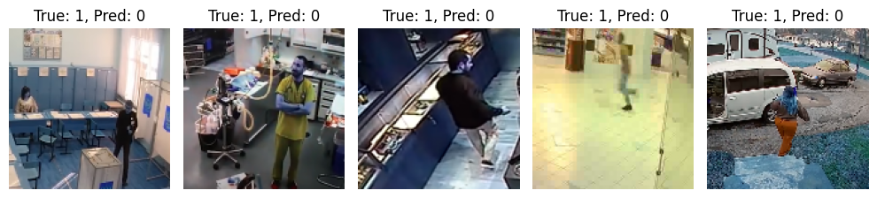
ERROR:
False positives occur when the model predicts a positive class incorrectly. In this case, the model might be overly sensitive to certain features, resulting in more false alarms.
False negatives occur when the model misses important positive cases. The model might need more fine-tuning to avoid underestimating certain features or patterns.

Slide 11
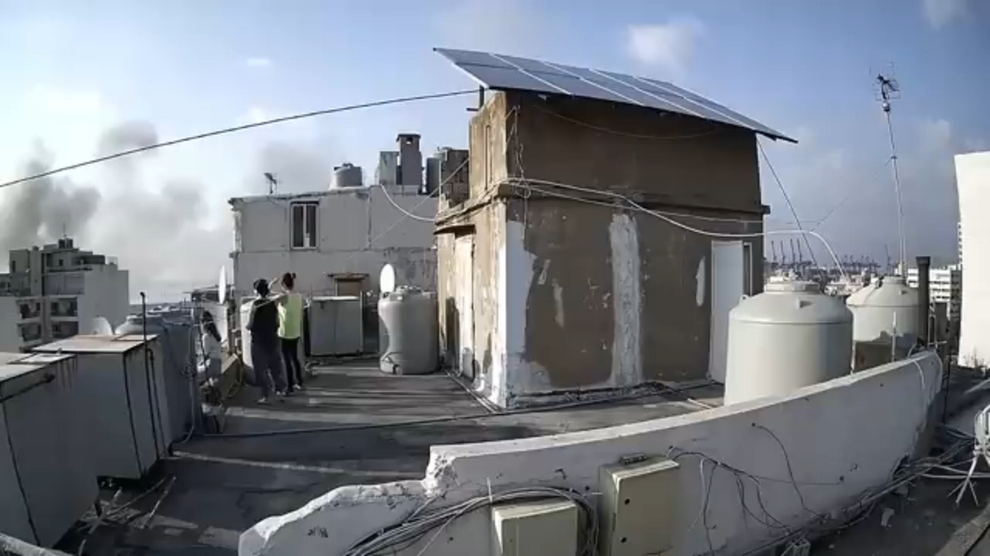
TESTING ON DIFFERENT DATA:
INPUT:

Slide 12
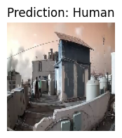
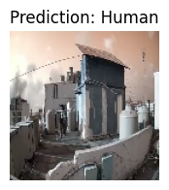
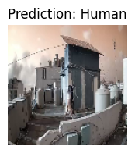
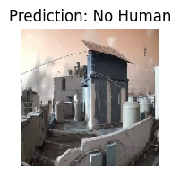
MODEL ON DATA

Slide 13

OUTPUT:

